Slide 1
VIDHYADEEP INSTITUTE OF MANAGEMENT AND TECHNOLOGY
Prepared By:
130940119091
130940119092
130940119093
Guided By :Jitendra Rasadiya

Slide 2
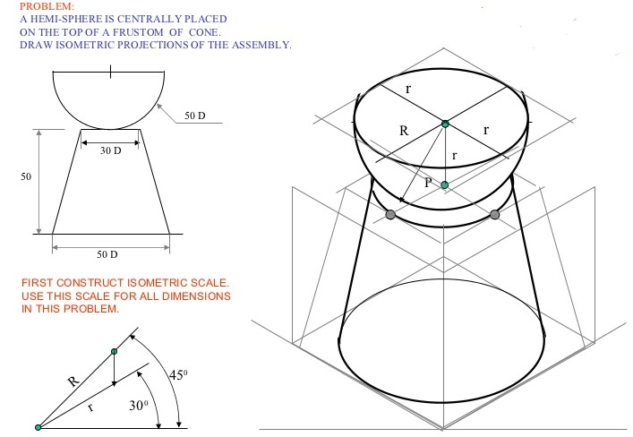

Slide 4
